Slide 1

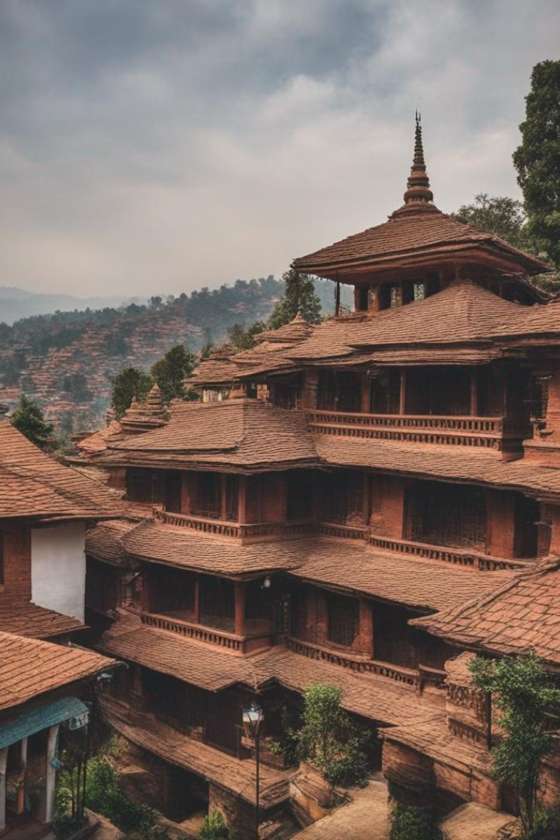


Dhulikhel: A Cultural Gem
Dhulikhel is blessed with many tangible built heritage assets, including the central "Old Town" area in Ward 5. This area is distinguished by two to four-story Newari-style residences with terracotta brick, mud plaster, terracotta gabled roofs, open windows, intricately carved wooden doors and windows, and a variety of decorative elements. The town also features pagoda-style temples, stone-carved statues, shrines, and intimate scaled medieval stone-paved streets. Other temples outside the old town include Shee Khandapur, Kali Temple, Gaukhureswor Mahadursthan, and Hazaar Sindhi.
by Atul Dhital

Slide 2
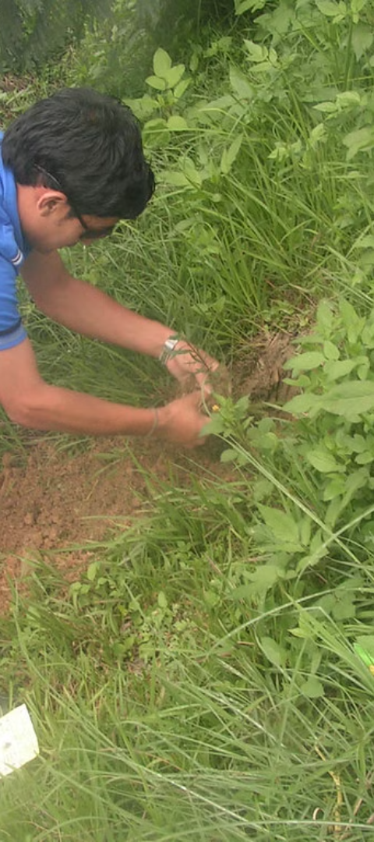
Tourist Accommodation in Dhulikhel
1
Diverse Options
2
Training Colleges
Dhulikhel offers a diverse choice of accommodation, including budget hotels, luxury hotels, and rural homestays. The majority of lodging is concentrated in urban regions, with new accommodation premises being the fastest expanding business category.
Dhulikhel has training colleges that teach students how to work in the hospitality industry, providing a significant resource for delivering high-quality lodging.
3
Major Hotels and Lodges
Notable establishments include Hotel Mount View Pty Ltd, Gaia Holiday Home, Hotel Gaurishanker Mountain View Pty Ltd, Dhulikhel Mountain Resort Kwawa, Himalayan Horizon Hotel Sun and Snow Pty Ltd, and Dhulikhel Lodge Resort.

Slide 3
Economic Activities in Dhulikhel
Tourism Revenue
Major Economic Activities
Tourism revenue is expected to provide a growing part of Dhulikhel’s foreign exchange revenues based on current trends. The industry has the potential to significantly enhance people’s living standards in the municipality by providing long-term job opportunities.
The Municipality has evident factors that provide a competitive edge for a variety of economic sectors, including agriculture, forestry, trade and business, transportation and logistics, and tourism.

Slide 4
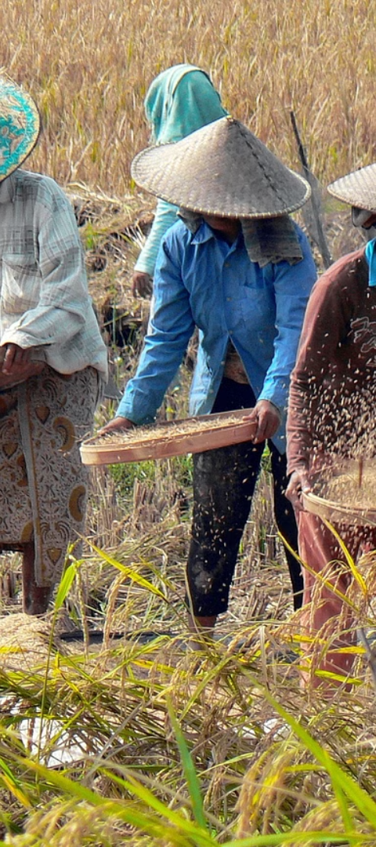
Agricultural Sector in Dhulikhel
1
Importance of Agriculture
2
Forestry
Agriculture is the region’s most important economic activity, providing both a living and a source of employment. The majority of people are employed in the production of cash crops such as rice, maize, and vegetables.
The region has Shorea robusta forest, Pinus roxburghe forest, and an intermediate zone of mixed forest, providing significant economic value through the sustainable utilization of forest resources.

Slide 5
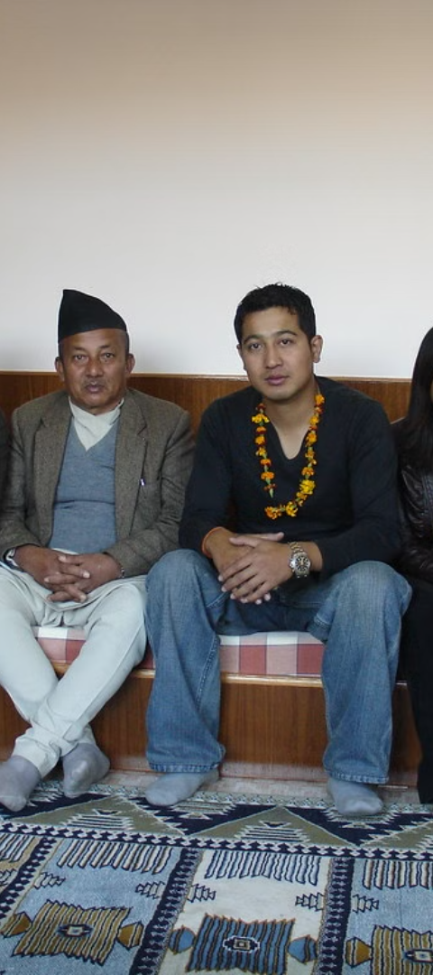
Trade and Business in Dhulikhel
Commercial Sector
Transportation and Logistics
Dhulikhel has a minor commercial sector known as Dhulikhel Bazar, which houses major banking institutions and retail establishments.
Dhulikhel serves as an important transportation and logistics center, with major national roadways linking the area.

Slide 6
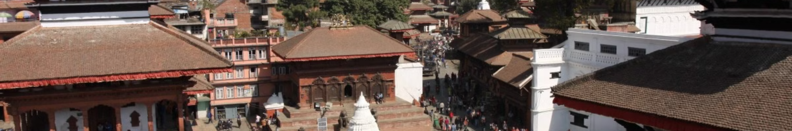
Tourism in Dhulikhel
Tourism Sector
1
Dhulikhel Municipality possesses natural, cultural, and religious attractions, resulting in a thriving tourism sector catering to domestic and international tourists.
2
Economic Impact
Tourism directly provides a significant number of full-time employment for local inhabitants and has the ability to significantly improve circumstances in the municipality.

Slide 7
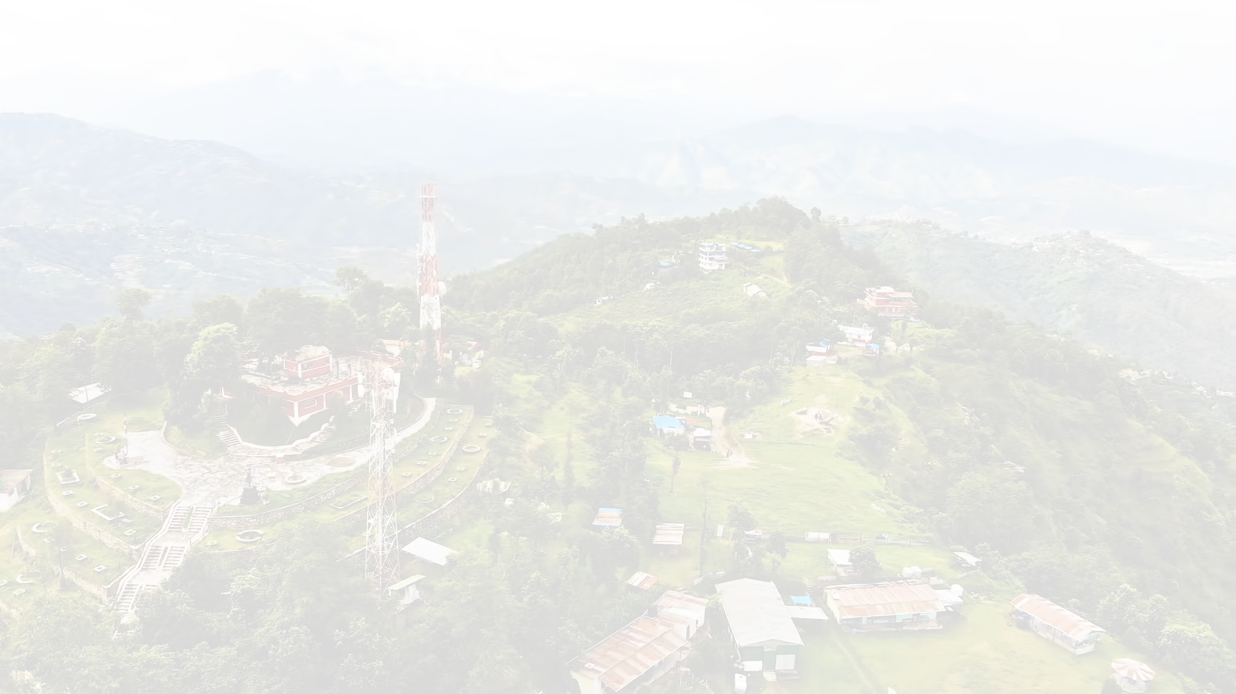
Discover the Hidden Gems of Dhulikhel
Escape to the idyllic town of Dhulikhel, where the stunning Himalayan views and rich culture await you. Explore the charming streets and traditional architecture of the historic town center, or venture out into the surrounding hills for a scenic hike. Whether you're looking for adventure or relaxation, Dhulikhel has something to offer every traveler. Don't miss out on this unforgettable destination!

Slide 8

Economic Activities in Dhulikhel
The Municipality of Dhulikhel has several factors that provide a competitive edge for a variety of economic sectors. Agriculture is the region's most important activity, with a variety of crops grown year-round. Forestry also provides significant economic value, while trade, transportation, and tourism are also major contributors to the local economy.

Slide 9
Tourism Development Strategies in Dhulikhel
The tourism development plan in Dhulikhel is based on six primary objectives, including the utilization of the municipality's historical and natural attractions, and the expansion and improvement of tourist accommodations and infrastructure. Specific measures are being taken to support these goals, such as developing a heritage strategy and establishing a Heritage Advisory Committee to support heritage decision-making.

Slide 10
Economic Impact of Tourism in Dhulikhel
25K
4
Full-time Jobs
Supplementary Services
Tourism directly provides a huge number of full-time employment for local inhabitants.
Income from different supplementary services for guests, such as arts and crafts production, has a positive economic impact.

Slide 11
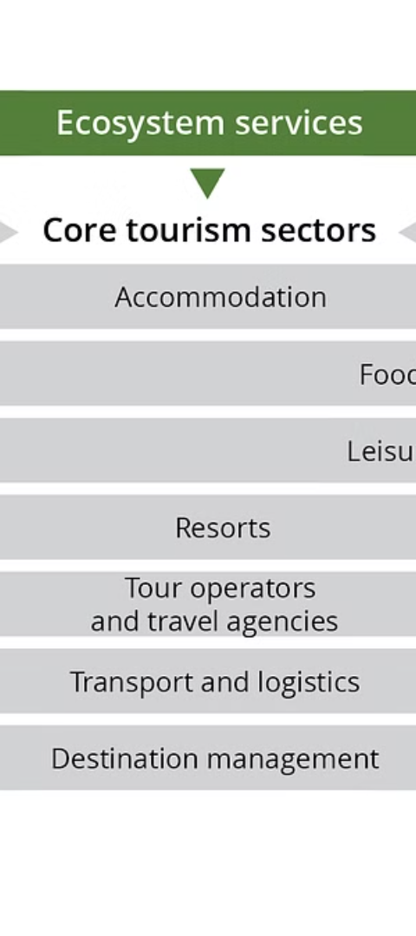


Tourism Development Issues in Dhulikhel
Concentration of Facilities
Hotel accommodation and tourist attractions are concentrated only in and around the bazaar area, limiting access to tourist destinations and activities.
Underutilized Areas
Rural and emerging areas have great potential but remain underutilized for tourism.

Slide 12
Preservation and Management in Dhulikhel
Major Historical and Landscape Values
Efficient management is required to safeguard and manage the development of major historical and landscape values within the municipality.
Integrated Strategy
To optimize tourist experiences, a more integrated strategy is required for intangible and tangible heritage.

Slide 13

Recommendations and Action Plan
To enhance tourism in Dhulikhel, it is crucial to promote its rich cultural and historical landmarks. Recommendations include increasing promotion efforts, engaging local communities, and developing infrastructure. An action plan should include a tourism development strategy, a list of future tourism places, and potential religious tours, trekking, and cycling routes.

Slide 14
Conclusion
Dhulikhel's successful blend of culture and tourism has brought financial prosperity while preserving its rich history. By attracting visitors and generating revenue for local businesses, the town has improved the community while maintaining its authentic social personality. However, it's important to maintain a balance to avoid over-commercialization. Dhulikhel is a great example of how cultural tourism can support long-term financial prosperity while safeguarding tradition.

